Slide 1
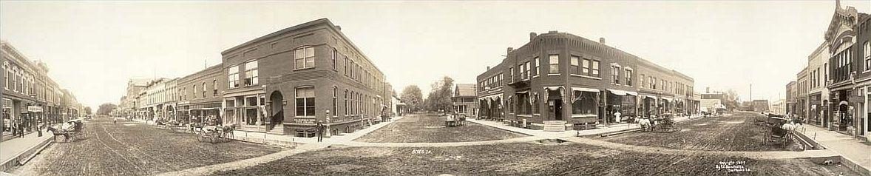
Predicting House Prices in Ames, Iowa
Using Machine Learning Techniques

Slide 2
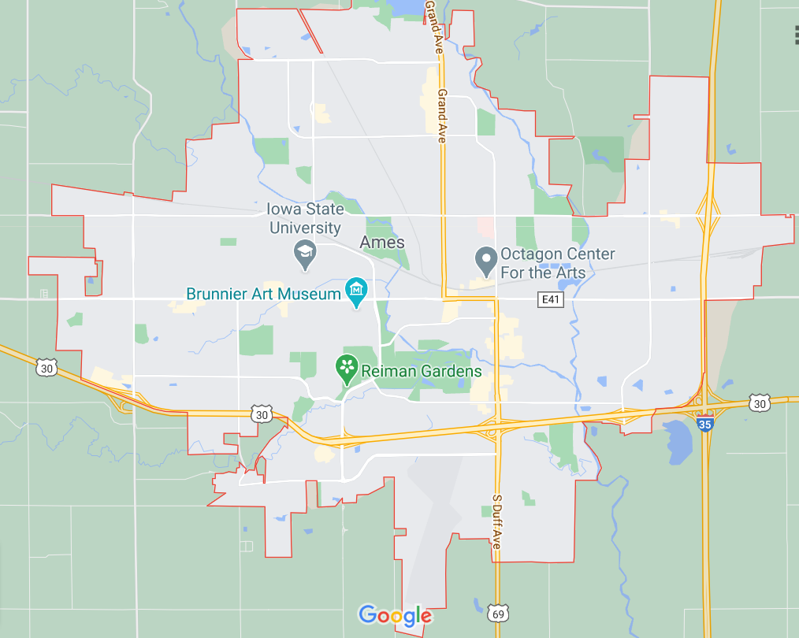
BACKGROUND
A city in central Iowa, located 30 miles north of Des Moines, the state capital.
In 2019, Ames had a population of 66,258.
Location of Iowa State University which makes up ONE-HALF of the city’s population.
In 2010, Ranked 9th on CNN’s “BEST PLACES TO LIVE” list.

Slide 3

Fun Facts About Ames, Iowa
Founded in 1864 as a station stop on the Cedar Rapids and Missouri Railroad
City is named after U.S. Congressman, Oakes Ames, who helped build the transcontinental railroad.
A blend of corn ethanol gasoline was first sold commercially in Ames as early as 1932.

Slide 4
Notable Residents of Ames, Iowa
Lee Teng-hui, President of the Republic of China
George Washington Carver, inventor
Jane Smiley, Pulitzer-Prize winning novelist
Herman Banning - 1st black flyer to obtain a federal pilot’s license and first black flyer to make a transcontinental flight
Michael Gartner, former president of NBC news

Slide 5
Objective
To create a predictive model using machine learning techniques in order to forecast the Sale Price of houses based on the characteristics of houses in this market.
For illustrative purposes, the target variable (‘Sale Price’) will be a female as a contestant on the popular television show called ‘The Bachelorette.’ The characteristics of each house will be similar to each bachelor looking to ingratiate himself to the eligible bachelorette.

Slide 6

Recommendation
Predictive modelling can be an effective tool to predict housing prices due to the various features houses contain or lack.
These techniques can lend valuable insight to potential home buyers, home sellers, and real estate agents. People can learn what characteristics are important and may increase value, decrease value, or which features have no effect on homes sales in the area.

Slide 7
Ames Housing Data Set
The Data in this dataset is derived from a study and paper written by Deen De Cock entitled, “Ames, Iowa: Alternative to the Boston Housing Data as an End of Semester Regression Project .”
The data set presented describes the sale of individual residential property in Ames, Iowa from 2006 to 2010. The data set contains 1460 observations and a large number of explanatory variables (23 nominal, 23 ordinal, 14 discrete, and 20 continuous) involved in assessing home values.

Slide 8


Meet Jessica
Meet Jessica. Jessica’s nickname is ‘SALE PRICE.’ She’s charming, friendly, and has a very outgoing personality. However, as much as she would love to be independent, she has the quality trait of a dependent person. Her mood and disposition is reflective of the man or men she is surrounded by. She LOVES independent men.

Slide 9

Meet the Contestants
In all, there are 80 independent men (features). They are all vying for Jessica’s attention and ultimately her heart.
Their aim is to see if individually or collectively, they can change her mood or figure out what makes her happy (predict the sale price).
Lets see if they have what it takes !!!

Slide 10
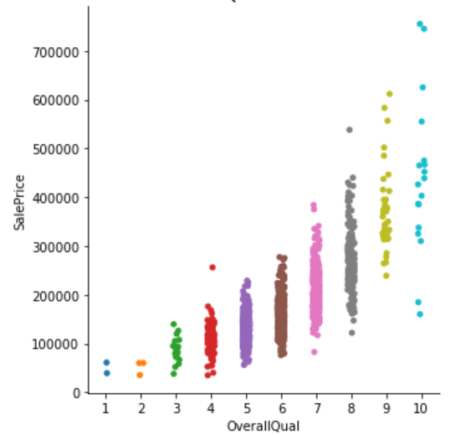
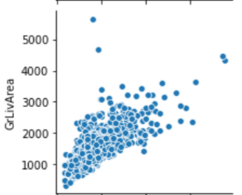
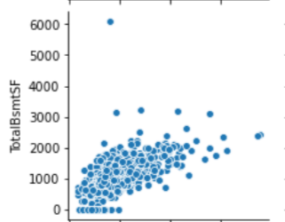
Lets explore the pool of eligible bachelors
On first look, It seems that Jessica (‘Sale Price’) has great chemistry with 3 of the eligible bachelors (‘Greater Living Area’, ‘Total Basement Square Footage’, and ‘Overall Quality’). However, first impressions can be deceiving. She may have good or bad chemistry (correlation) with some of the other contestants. Lets investigate further.

Slide 11
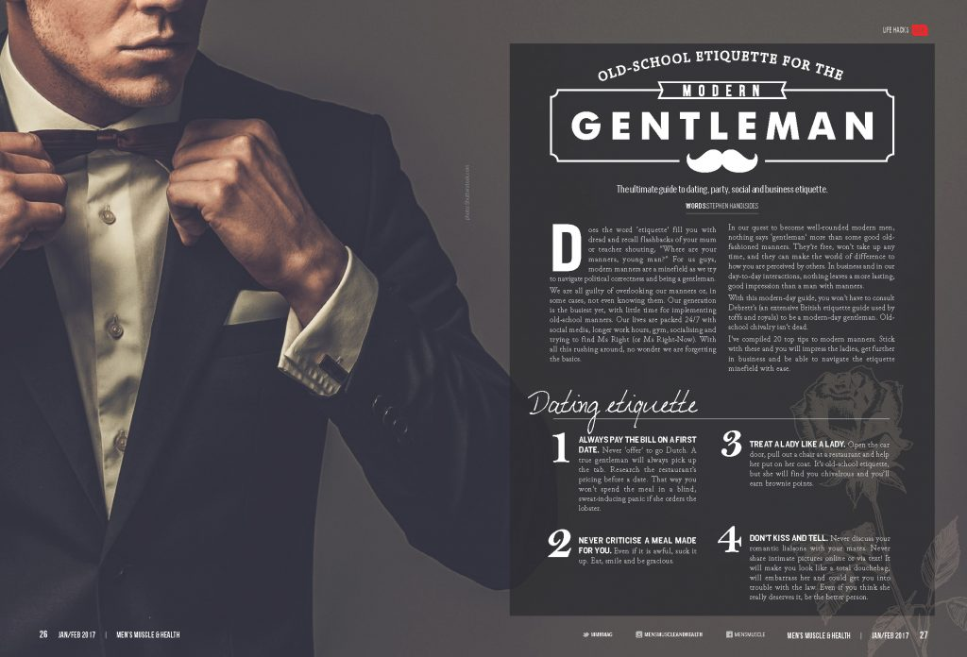
WAIT….There seems to be a problem
Some of the guys (independent variables) seem to be seriously lacking some personality traits (missing values). Lets see if we can recommend taking those guys to etiquette class (cleaning data) to improve their chances of being suitable for Jessica.

Slide 12
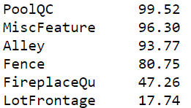
Etiquette Techniques
The pool of suitors seems to be diverse. Some of them have serious character flaws (a lot of missing values) but most of them seem to have great character (no missing values).
Only the ones who have major deficiencies will be required to go to etiquette class and correct their flaws. The proven method to improving character traits seems to be to take their strongest attributes and refine them in order to make them better (impute the missing values with either the mean or the mode or ‘NONE’ if the property does not possess the necessary trait)
The chart to the right represents the percentage of contestants
who have a high percentage of missing values. They will need
the most attention in etiquette school

Slide 13
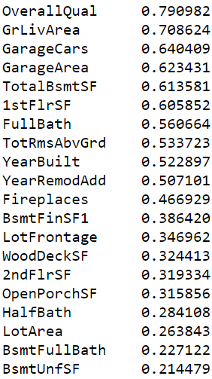
Chemistry
For the numerical group, the competition is tight. Jessica has chemistry with the entire group ranging from extremely high chemistry to relatively low chemistry.
There are also some that she has absolutely no chemistry with, but we’ll address that later

Slide 14
One Hot encoding and Get Dummies
The other two groups have to go to a different school than etiquette school. They must receive ONE HOT encoding training and Get Dummies training for Jessica to even consider them to be an adequate match.
After the contestants attend the proper training sessions, then they will be eligible to go on a group date in order to see how their collective chemistry coincides with Jessica and have the ability to influence how she feels about them.

Slide 15

Dinner Dates
Dinner dates have been scheduled with Jessica in groups. The objective is that they all get to know her better and for her to see how she interacts with each of them.

Slide 16
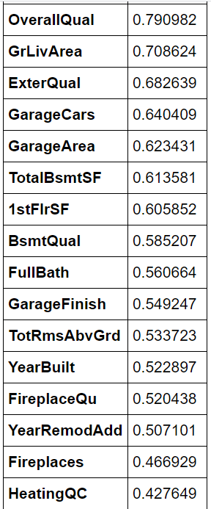
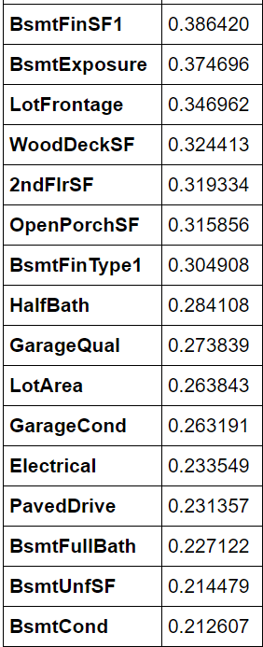
Dinner Date Results
After the conclusion of the dinner dates. Jessica has measured her compatibility with the entire pool of contestants.
The chart to the left indicates how much positive attraction she had to each of the individual contestants (correlation). On a scale from 0-1.
Her next trip is to the relationship expert for some advice.

Slide 17
First……..Feature Engineering
2 new contestants are added. Their names are essentially ‘Age of Property’ and ‘Years Between Remodelling and Sale.’ Their personalities make the contestant pool more dynamic.
Other contestants were removed because they were too similar to one another (multicollinearity) and not unique enough for Jessica to be compatible with them. There is no sense in confusing her and getting a guy who is similar to another guy. She might as well only consider the ‘Real McCoy.’
Then we removed more contestants, not because of multicollinearity, but because they were redundant features and would cause the Love Advisor’s test to be inaccurate.
After the pool of contestants was decreased from 80, there were a total of 47 contestants remaining and competing for Jessica’s love.

Slide 18

Relationship Advice
The relationship advisor is an expert in her field. Her science is not 100% accurate, but her formulas will give Jessica better insight on which man or which 5 men have the ability to make her the happiest.
She runs of series of tests based on what Jessica has told her. The tests she runs are called:
1. Love - Linear Regression
2. Compatibility - Ridge Regression
3. Convenience - Bayesian RIdge Regression
4. Chemistry - Lasso Regression
5. Similar Interests - Elastic Net Regression

Slide 19
Splitting the Groups
Train-test split - Now it is the time to separate the groups from one another. We’ll place all of the males into one group (X) and we’ll place Jessica into a group all by herself (y).
Splitting the data allows us to create a training set and a test set. In total, there are 1460 observations. So approximately, 1166 observations will be in the training set and 292 observations will be in the test set.

Slide 20
Tests Performed
Each test is unique and different. Each test will identify the contestants who have the highest chance of making Jessica happy (predicting sale price).
Although the tests are different, they each return a quantifiable score which can then be compared against the other tests to see which men have the best chances of making her happy and also which men have the highest likelihood to make her sad.
Each test will return a result called an R2 score. The results will be evaluated and compared utilizing a scale ranging from 0 to 1

Slide 21
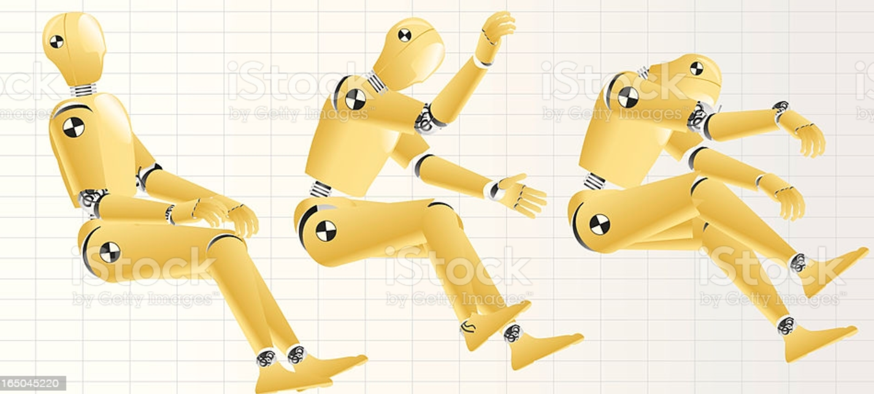
Dummy Regressor Test
This is a regression test performed to get a baseline for the Love Advisor’s tests. This result will be compared against the results of the 5 tests to see how the dummy test compared to her tests.

Slide 22
Dummy Regression Test Results
For a baseline on a Dummy Regression test. This test may not have good results because of multicollinearity (many of the guys have similar attributes and are too similar to make a clear distinction between each of them as they all have a similar ability to change Jessica’s mood), but it is a starting point.
Dummy Test R2 Score - -0.052565
The baseline does not look to be that great, so hopefully it gets better from here.

Slide 23
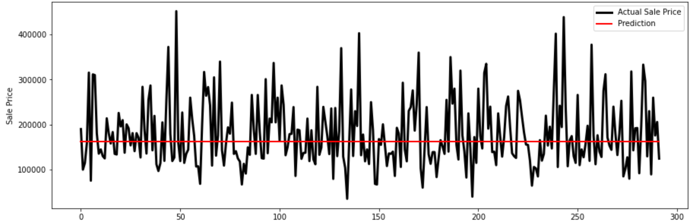
Dummy Regressor Test Results
This is an illustration of the Dummy Regressor test. The red line represents the median and is the predicted value of the house (how Jessica feels about the gentleman). The black line represents the actual value of the houses sold. Looks like there is a FLATLINE here. Hopefully we can breathe some life into Jessica’s love life.

Slide 24
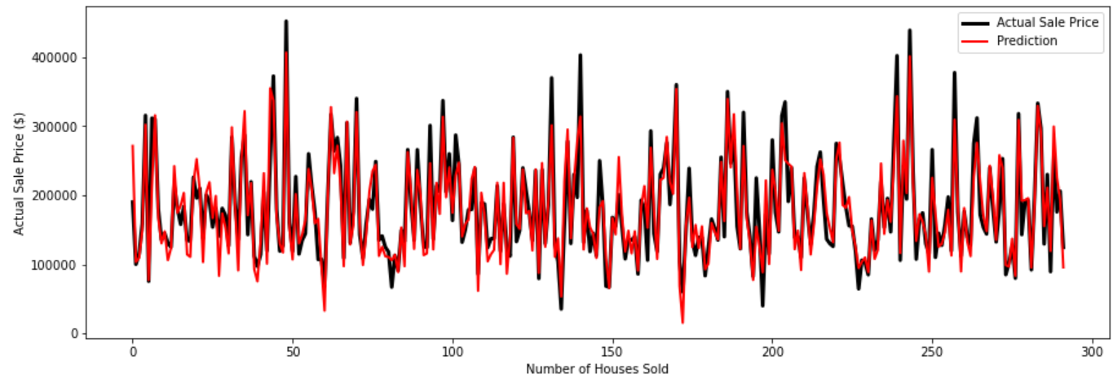
Love - Linear Regression Test
This love test seems pretty good. The Love Advisor has shown that the selected contestants have a pretty good chance at making Jessica fall for them (predicting sale price). R2 Score - 0.85479

Slide 25
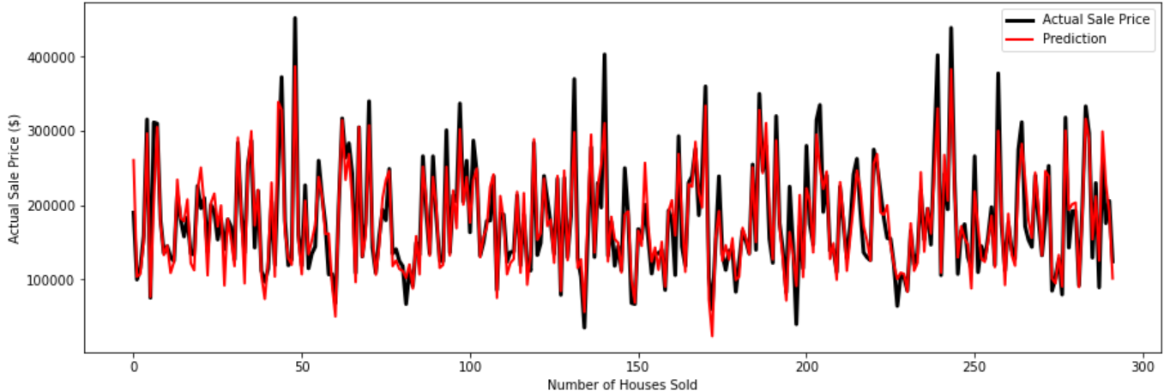
Compatibility - Ridge Regression
This Compatibility test seems to be slightly better than the Linear Regression test. . The Love Advisor has shown that the selected contestants have a pretty good chance at making Jessica fall for them (predicting sale price).
R2 Score - 0.0.8638

Slide 26

Convenience - Bayesian Ridge Regression
This test seems to be slightly worse than the Ridge Regression test, but better than the Linear Regression test. It seems like the guys are pretty good at making Jessica fall for them.
R2 Score - 0.8558

Slide 27
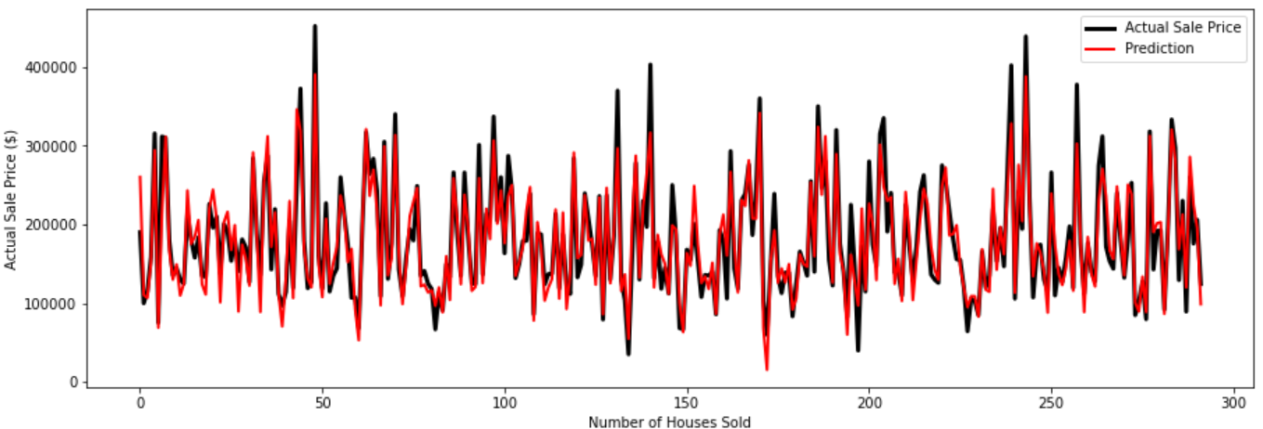
Chemistry - Lasso Regression Test
So far, this test seems to have the best score out of all of the tests performed. The pool of gentleman selected in this test may have the best chance to win Jessica’s heart.
R2 Score - 0.8657

Slide 28

Elastic Net Regression
While the results of the test are not necessarily poor, relatively speaking, they are not as good as they are for the four previous tests. Now we’ll compare all of the results against each other.
R2 - Score - 0.849987
While the results of the test are not necessarily poor, relatively speaking, they are not as good as they are for the four previous tests. Now lets compare all of the results against each other

Slide 29
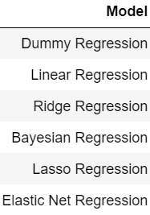
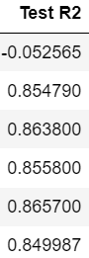
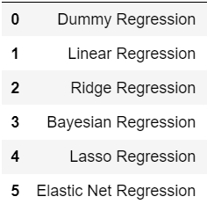
Model Comparison

Slide 30
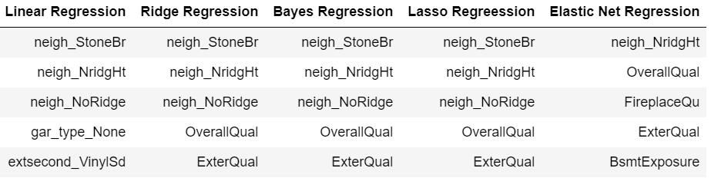
Top 5 Finalists per Test
According to the results of the tests, these are the results of the top 5 contestants per test performed. In other words, these five guys will have the most influence on Jessica’s heart. The top 3 seem to almost be a consensus as they score high in 80% of the tests. Maybe true love does exist after all.

Slide 31
Conclusion
Based upon the multiple tests run, it seems like the Chemistry (Lasso) Regression test performed the best of all of the tests. There is a certain error rate that will come with any predictive model, but this model effectively predicts the housing prices based on the input.
The recommendation would be to use any one of these models to predict housing prices, as clearly certain features have a positive effect and negative effect on the market prices.

Slide 32

As for Jessica……..
She took the advice of her Love Advisor and has narrowed the field of suitors down to 5. She prefers to take her time before she makes a lifelong decision. Who knows what the future may bring or who will be selected after all, but she believes that sometimes the journey is more rewarding than the destination.
Stay tuned for the season finale to see if TRUE LOVE really does exist.

Slide 33
THE END

